Slide 1
The MOVIES
A analysis of imdb movie data
By Iamduffman

Slide 2
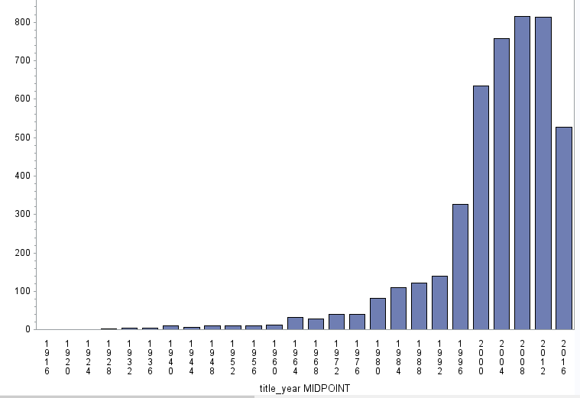
Initial analysis
Shows an increase In movies produced over the years

Slide 3
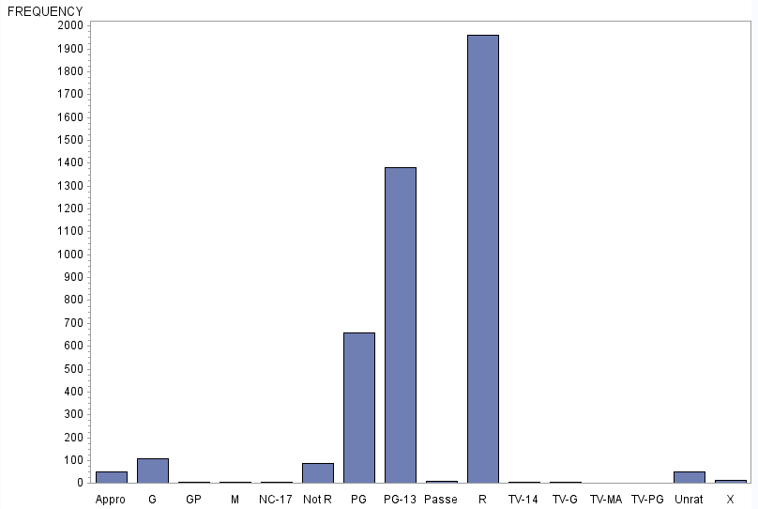
Initial analysis

Slide 4
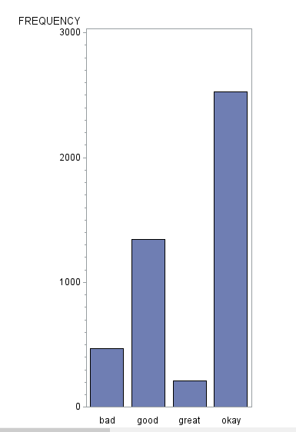
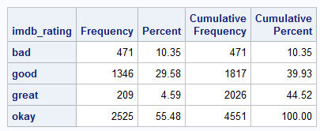
Initial analysis
Chart shows the frequency of bad, okay, good and great movies in the data set.
The average Imdb rating Is 6.423
Bad is <5
Okay is > 5 < 7
Good is 7 < 8
Great is > 8

Slide 5

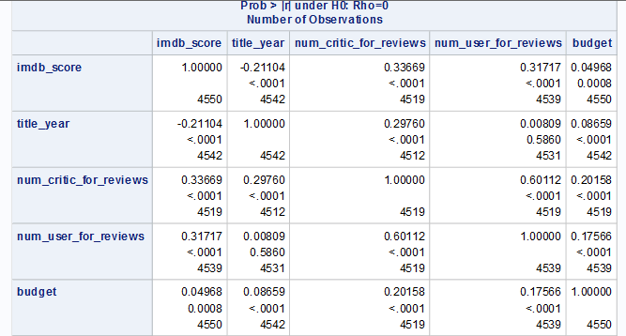
Initial analysis
Imdb ratings are mostly effected by number of user and critic reviews

Slide 6
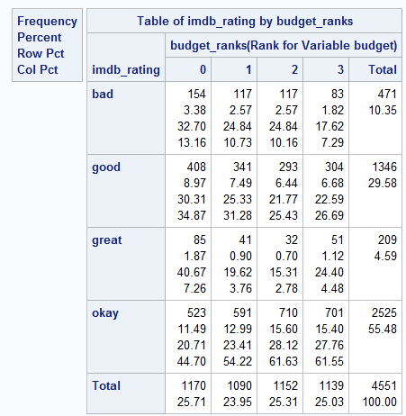
A further look…
Budget ranks represents the quantile that the movies budget falls in.
Interestingly the lowest budgeted films have the highest amount of great films

Slide 7
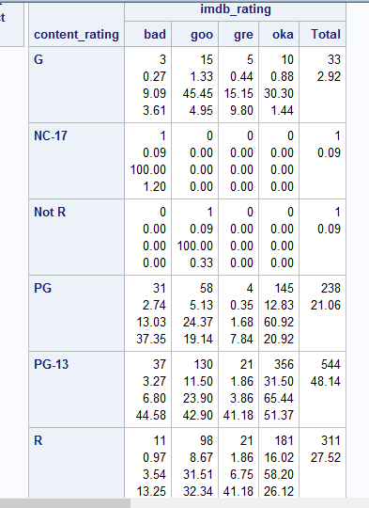
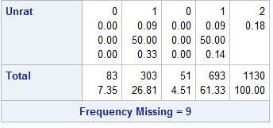
High Budget films
Sub-setting the data, I can now more specifically look at high budget films
Mean score = 6.45

Slide 8
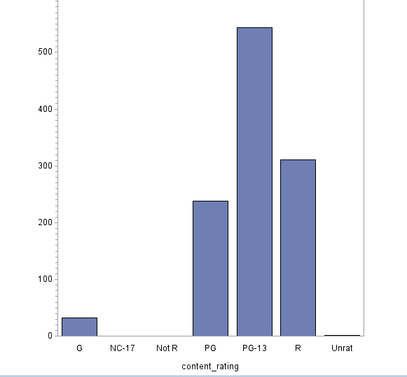
High Budget films

Slide 9
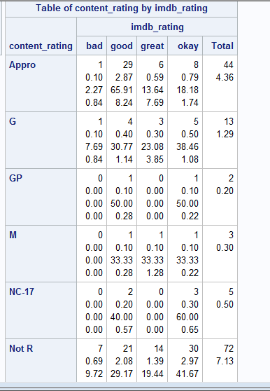
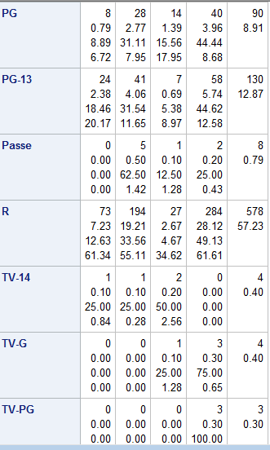
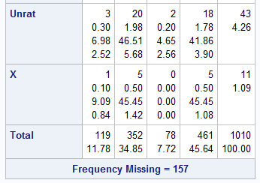
Low-budget films
Clearly low-budget films have more variety in there ratings
Great rated films occur most frequently from R rated films
Mean score = 6.47

Slide 10
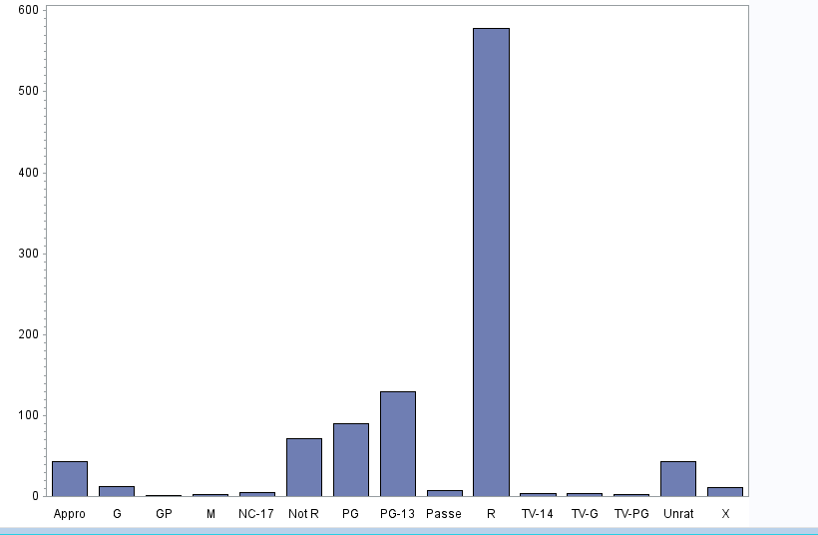
Low-Budget Films

Slide 11

But high budget films are better right?
First tested the distribution using Chisqr
Performed Wilcoxon Rank-Sum to test the mean scores between high and low budget films

Slide 12
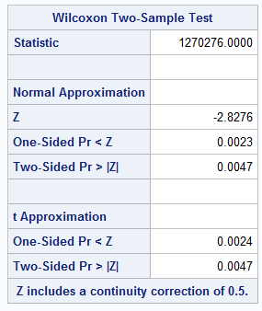
Rank Sum
The test shows a difference in the mean scores for high and low budget films

Slide 13
Conclusion
The number of films being produced increased each year since 1936
Many of the highest rated films are low budget
Low budget films score higher ratings than high budget films in this data set
The most frequently observed content ratings for movies are R and PG-13 rated films

Slide 14
Sources
Kaggle.com

